Slide 1
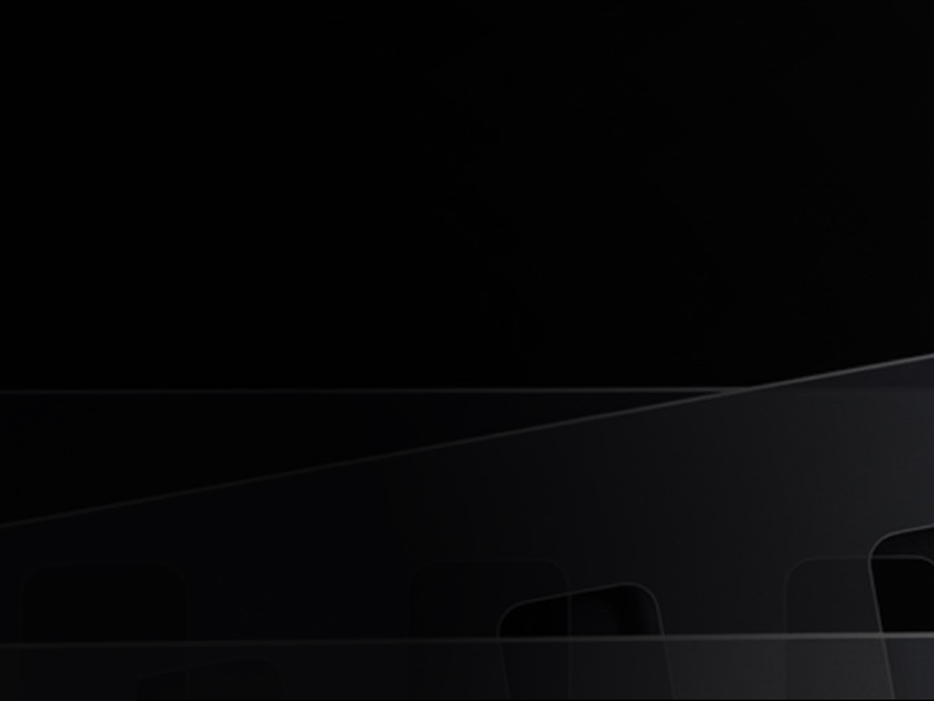
3D Modeling
Tutor : Liyan Chen
Email: chenliyan@xmu.edu.cn

Slide 2
Chapter 7
Material and Textures

Slide 3
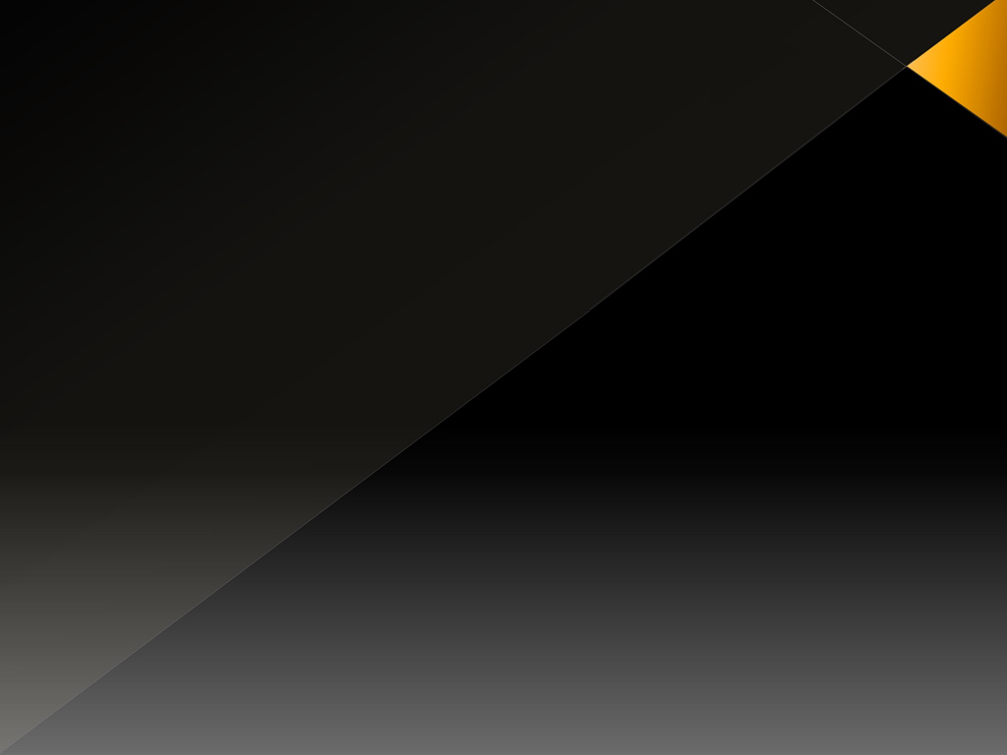
1. Basic Knowledge of Material and Textures
Visual representation of the object surface includes two aspects:
Material and Textures
The material is a surface basic attribute. For example, wood, metal or glass belong to the category of the material.
Texture adhesion on material, such as rusty steel plate, peony motif of silk fabrics , the crack of the glass and so on.

Slide 4
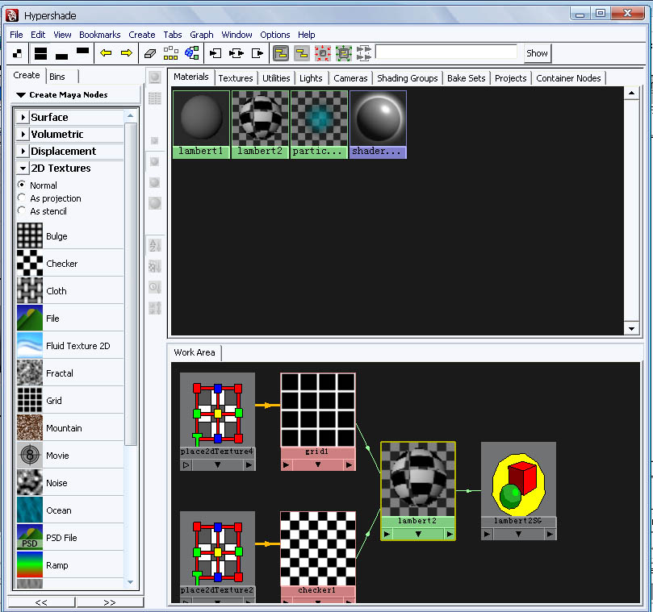
2. Hypershade

Slide 5
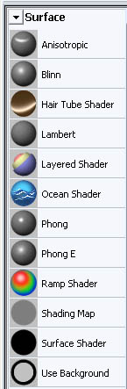
3. Basic Material
MAYA material system includes 5 types of basic material:
1、 Anisotropic
2、 Blinn
3、 Lambert
4、 Phong
5、 PhongE

Slide 6
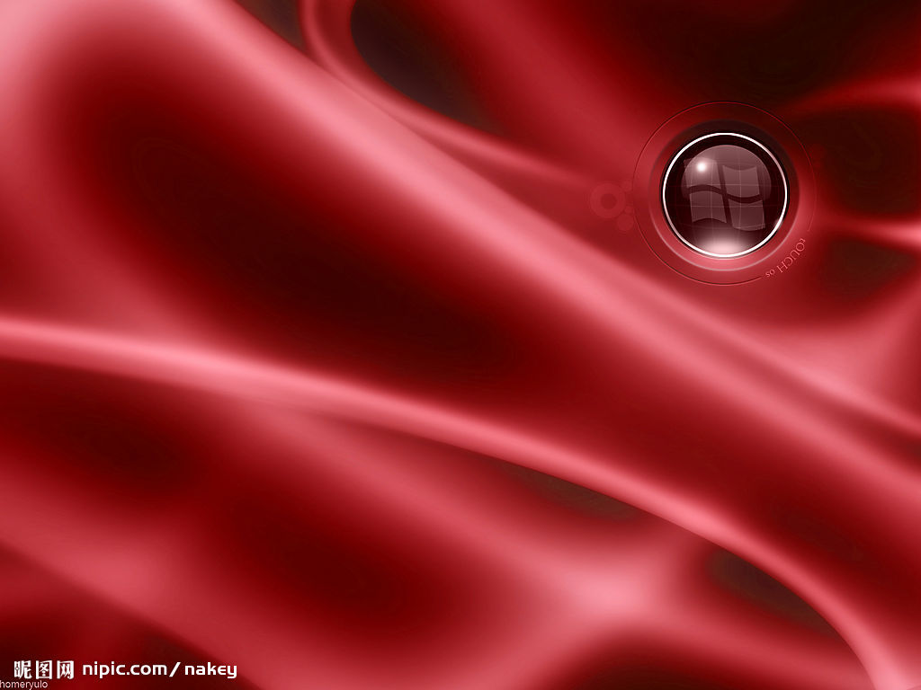
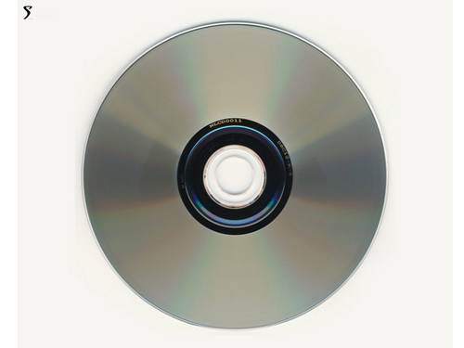
Anisotropic
Special high light effect caused by the reason of the groove or the scratch , such as: hair, silk, feather and cd-roms.

Slide 7
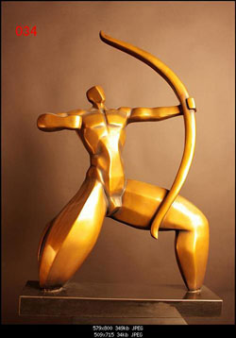
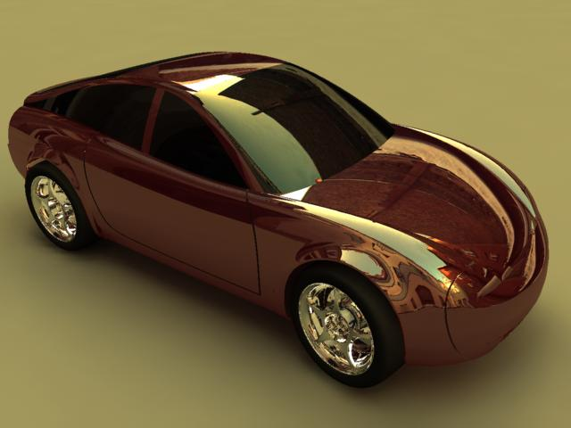
Blinn
It can produce soft highlights and specular reflection. It generally used to simulate the metal and glass

Slide 8
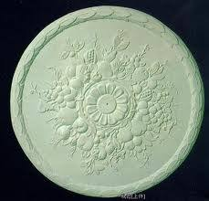
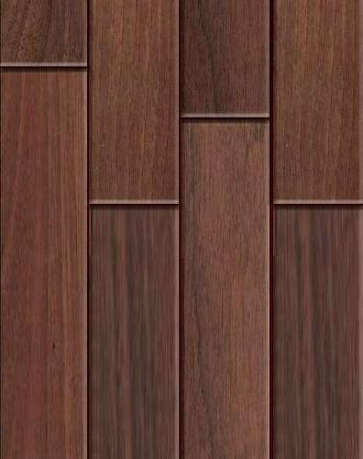
Lambert
It’s surface has no specular and reflection effect, suitable to simulate the non-reflective surfaces, such as: walls, gypsum and wood, etc.

Slide 9
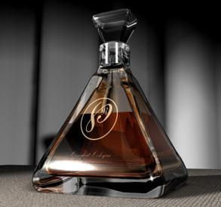
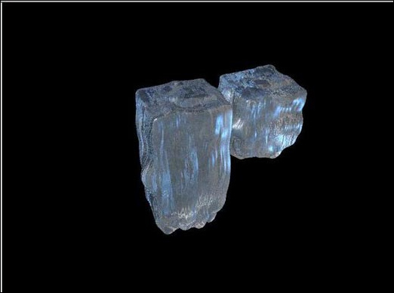
Phong / PhongE
It can produce very bright highlights, with strong specular effect, suitable for simulation model of high reflective surfaces, such as: water, glass, mercury surface, etc.

Slide 10
4. Special material
1、 Layered Shader
2、 Shading Map
3、 Surface Shader
4、 Use Background
5、 Hair Tube Shade
6、 Ocean Shader
7、 Ramp Shader

Slide 11
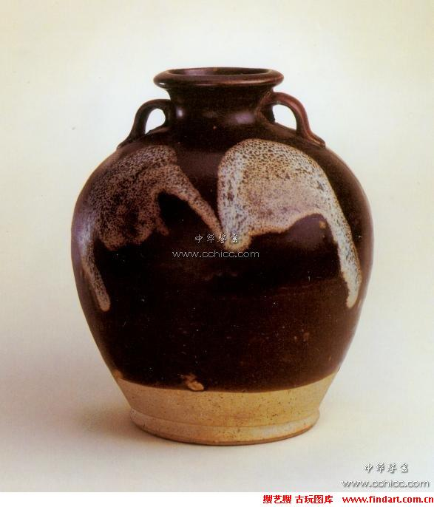
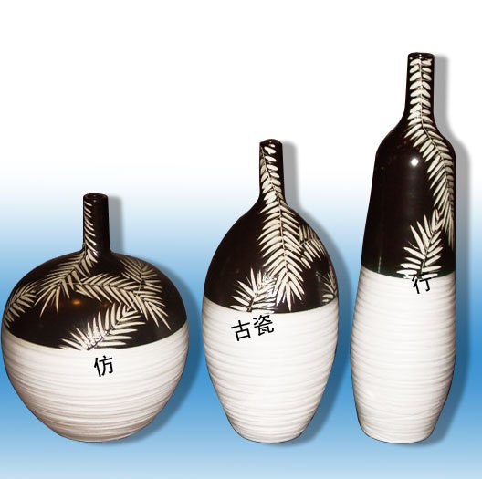
Layered Shader
Combine several different materials together
to have a complex effect

Slide 12
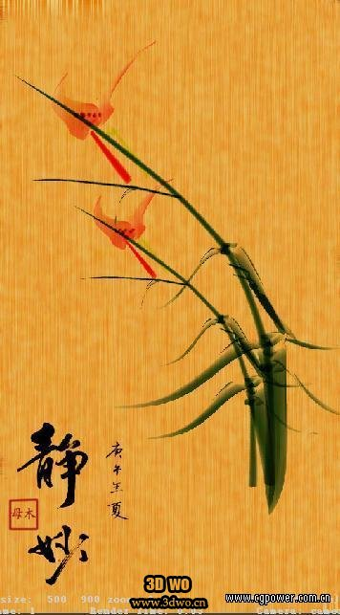
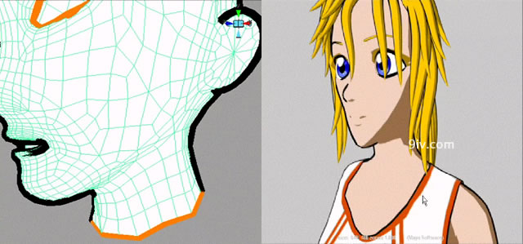
Shading Map & Surface Shader
Create and use material independently, there is no volume change in object surface, which needs to be combined with other materials and textures. It can be used in creating traditional Chinese painting , 2d cartoon and other special material effect.

Slide 13
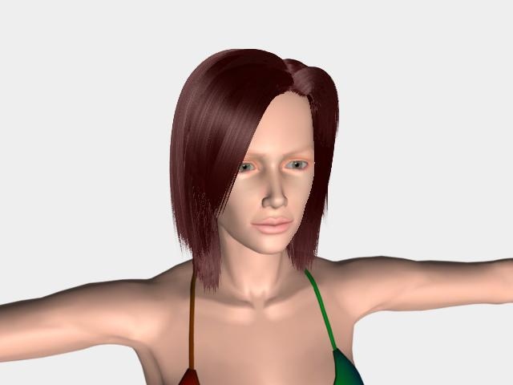
Hair Tube Shade
It has Hair strips highlight effect, which is often used in making hair. Create Hair system in MAYA, then change Hair into polygon, in this way, Hair Tube Shade material will be created automatically and connect with polygon hair at the same time.

Slide 14
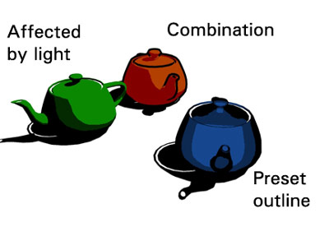
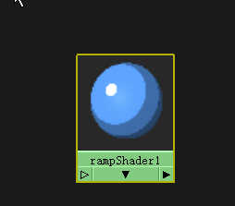
Ramp Shader
It is suitable for simulate cartoon effect.

Slide 15
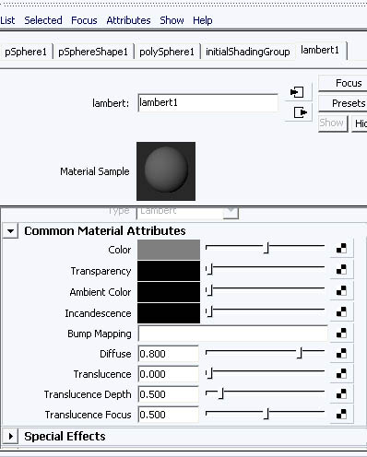
5. Material Attribute
Essential attribute：

Slide 16
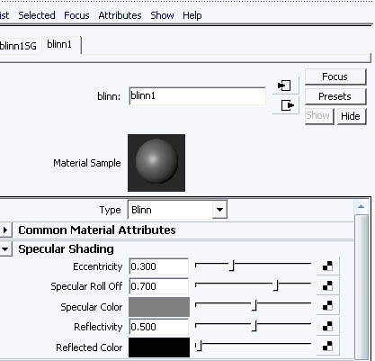
Specular Shading:

Slide 17
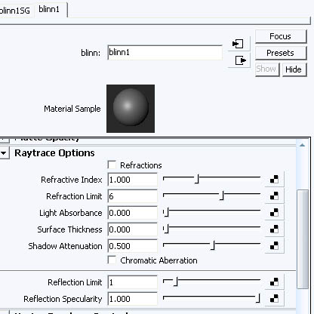
Refraction properties:

Slide 18
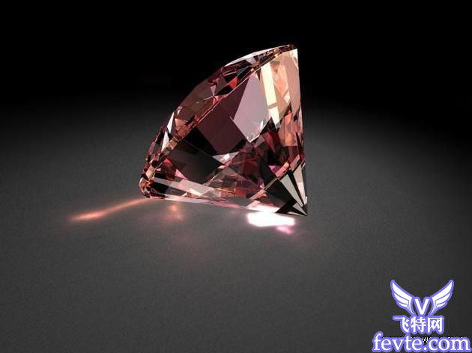
Refractive Index：
Refractive index of different transparent objects will be different. When the refractive index of 1 don't bend, the refractive index of common objects is as follows:
Air 1
Water 1.33
Glass 1.44
Quartz 1.55
Crystal 2
Diamond 2.42

Slide 19
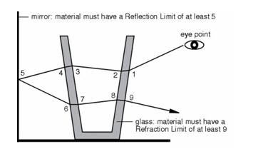
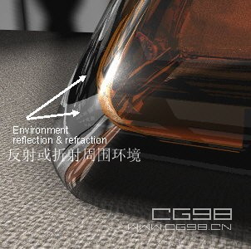
Refraction Limit:

Slide 20
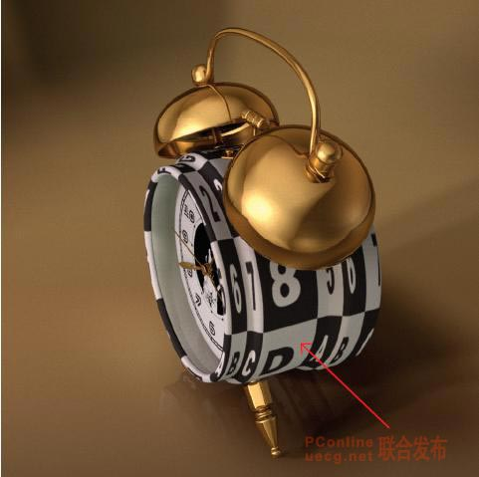
6. Texture Mapping
2D Texture
2D texture can be texture file or program texture. It according to the UV coordinates.

Slide 21
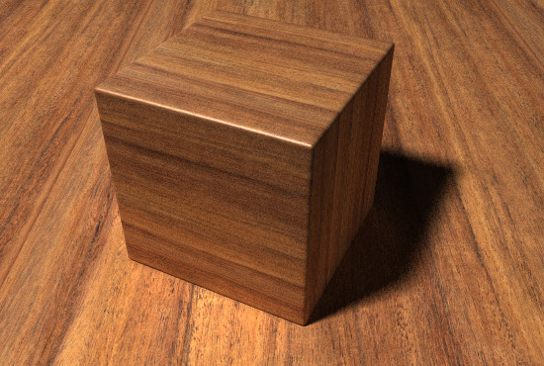
3D Texture
3D texture is program texture. It is not based on the UV coordinates of model, but according to the 3D map location coordinates of objects.

Slide 22
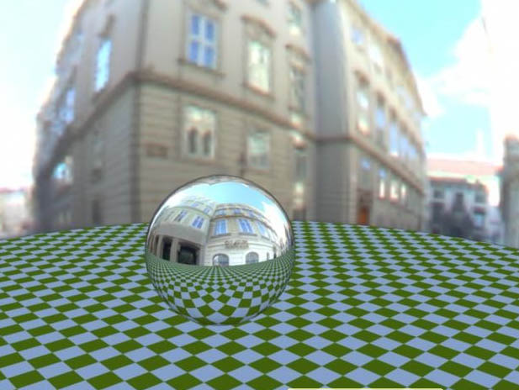
Environment Mapping
It is mainly used to simulate a reflection of the object to the outside world.

Slide 23
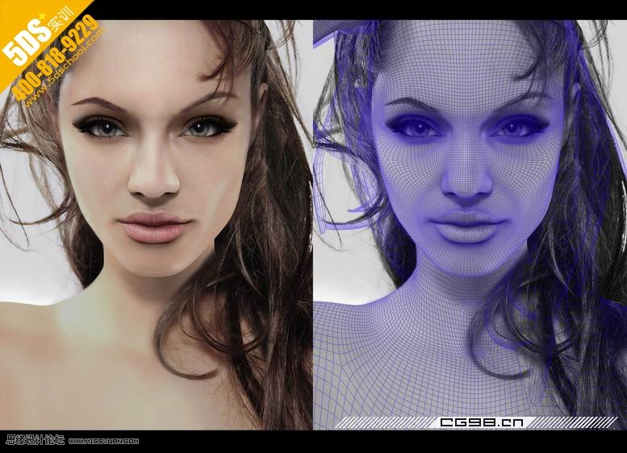
7. Case: misss_fast_skin_maya

Slide 24
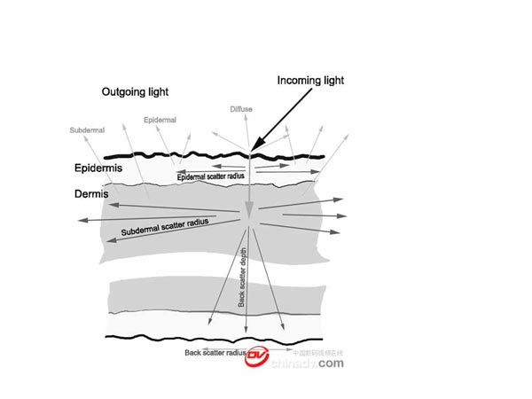

Slide 25
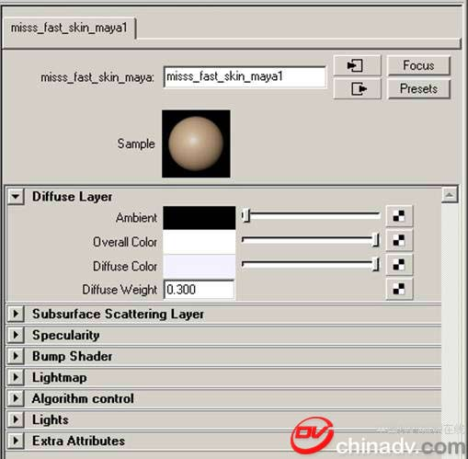

Slide 26
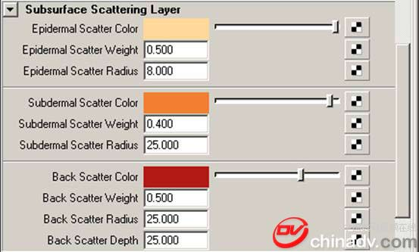

Slide 27
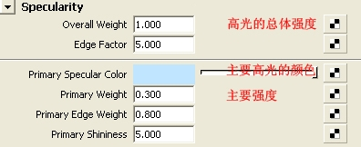

Slide 28
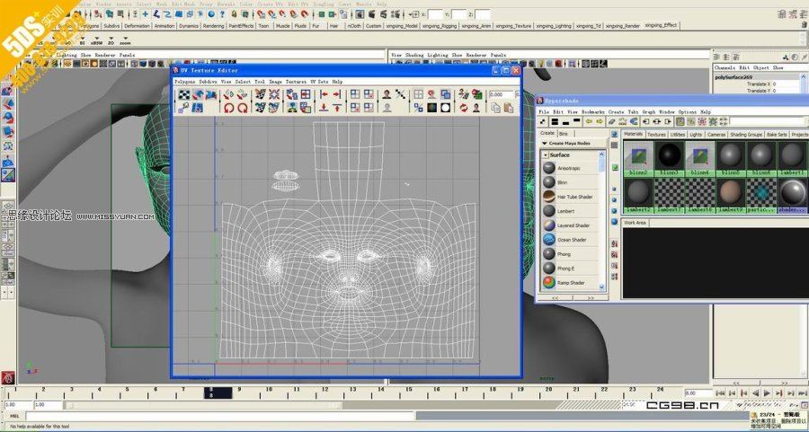

Slide 29
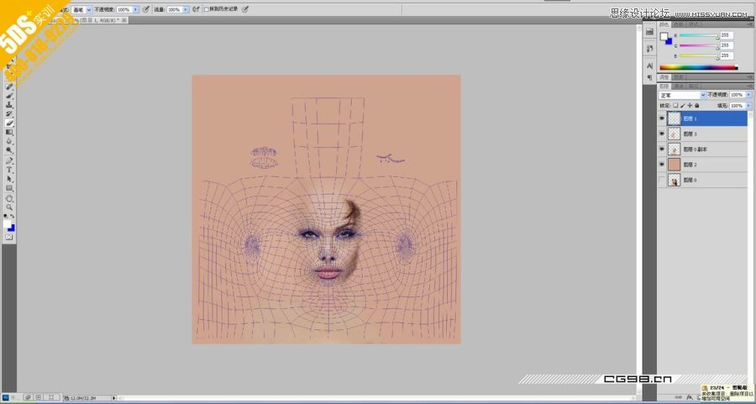

Slide 30
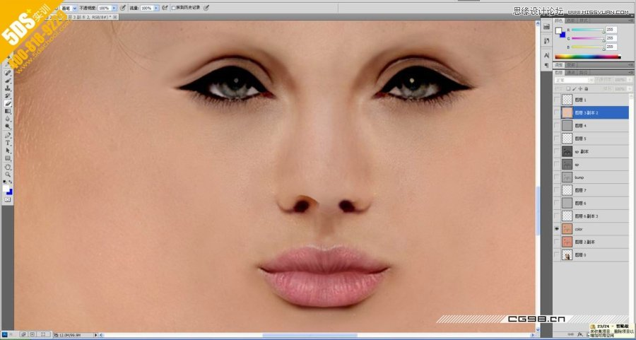

Slide 31
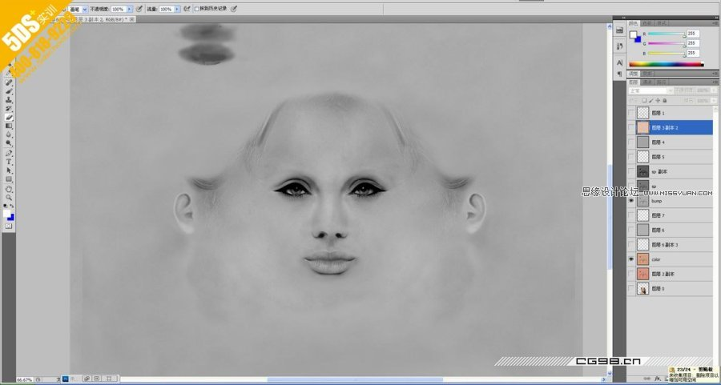

Slide 32
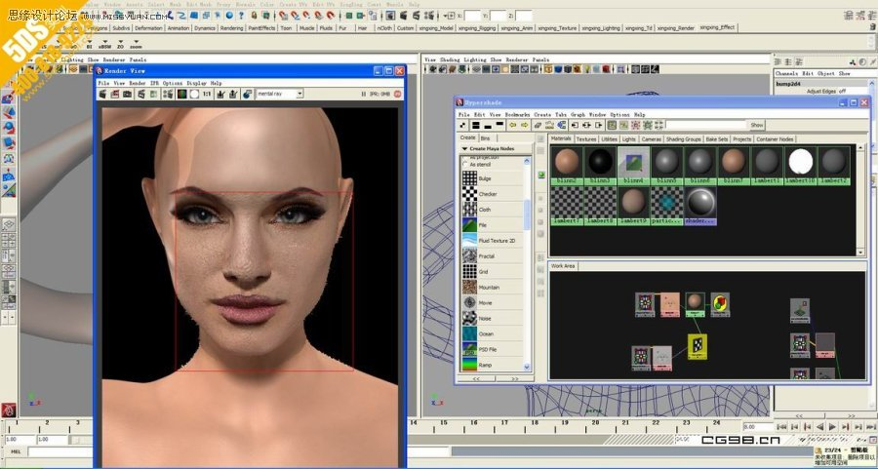

Slide 33
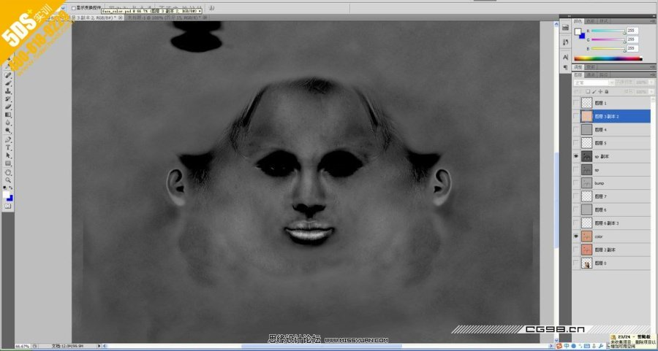

Slide 34
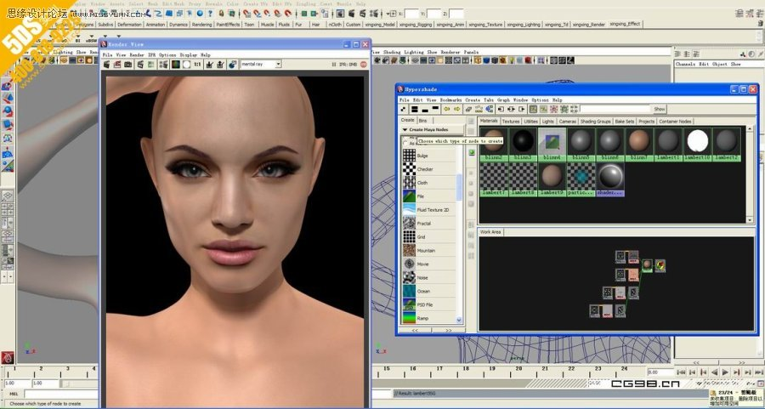

Slide 35
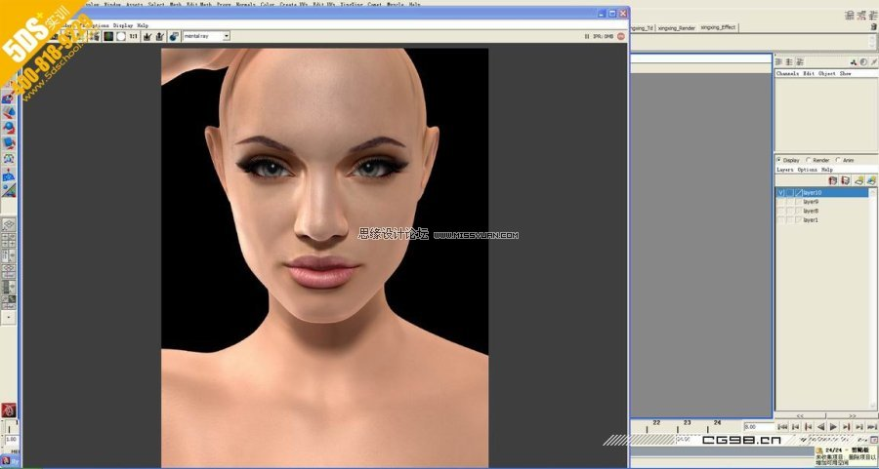

Slide 36
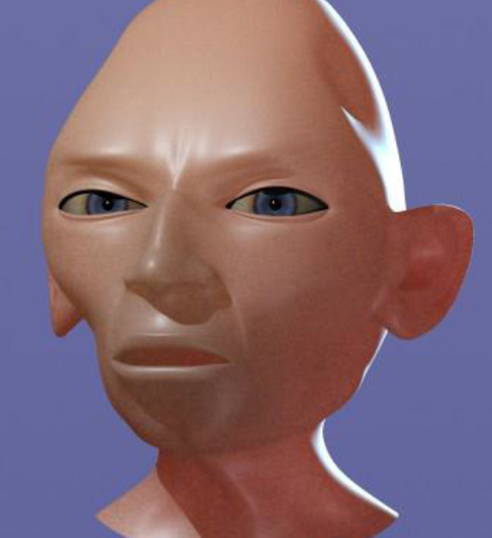
problem:

